Slide 1
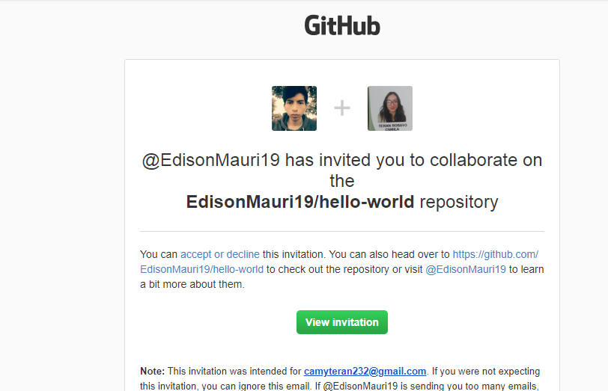
WS_0.1_InvitationGithub

Slide 2
